Slide 1

FIFA’19 PLAYERS ANALYSIS Data Mining – DSCI 5240 GROUP 12 PROJECT PRESENTATION
UNDER THE GUIDANCE OF
Dr. Robert Getty

Slide 2
EXECUTIVE SUMMARY
The dataset can be used as a basis to select players for the upcoming FIFA across the globe by focusing on the below objectives:
Is the potential of a player dependent on his age?
To create the best model for predicting the potential of a player based on several attributes.
We used Linear Regression to find whether the potential of a player is dependent on his age and other skill sets or not. For predicting the best model among we have created various models varying from Regression to Auto neural and then fed the outputs to Model Comparison. This model comparison will fulfil our second objective.

Slide 3
DATA SET DESCRIPTION
We had chosen a dataset that contains detailed attributes of 18207 players registered in the latest edition of FIFA’19 database.
There are 89 attributes which includes some of the personal information of players like age, nationality, name, wage etc., and players skill information like ball control, dribbling, crossing, finishing, GK skills etc.
This dataset consists of both nominal and interval variables and there are variables in this dataset which can be used for prediction and decision making

Slide 4
The main variables used for this project are age, potential, value, wage and all the skills set of the players. Age and potential are used for linear regression model.
Variable name | Description
ID | Unique id for every player
Name | Name of the player
Age | Age of player
Potential | Potential rating
Value | Current market value
Wage | Yearly earning through the team
Contract Valid Until | Date until which the player signed the contract
LS, ST, RS, LW, LF, CF, RF, RW, LAM, CAM, RAM, LM, LCM, CM, RCM, RM, LWB, LDM, CDM, RDM, RWB, LB, LCB, CB, RCB, RB, Crossing, Finishing,HeadingAccuracy, ShortPassing, Volleys, Dribbling,Curve,FKAccuracy,LongPassing, BallControl,Acceleration,SprintSpeed,Agility, ReactionsBalance,ShotPower,Jumping,Stamina, Strength,LongShots,Aggression,Interceptions, Positioning,Vision,Penalties,Composure, Marking, StandingTackle,SlidingTackle,GKDiving, GKHandling, GKKicking, GKPositioning, GKReflexes | Skills set rated on a scale of 1-100

Slide 5
VARIABLE ROLES
Input variables : Acceleration, Age, aggression, Agility, Balance, Ball control, Composure, Crossing, Curve, Dribbling, FKAccuracy, Finishing, GK Diving, GKHandling, GKKicking, GKPositioning, GKReflexes, Heading Accuracy, International_reputation, jumping, LongPassing, Longshots, Penalties, Shortpassing, ShotPower, Skill_moves, SlidingTackle, StandingTackle, Strength, and Value.
Target variable : Potential
ID : Variable ID is set to ID as it is used to uniquely identify values of each player
Rest of all variables are set to rejected as they are out of our project scope.

Slide 6
DATA ANALYSIS
We have carried out the following tasks before applying models on them:
Data Preparation
Data Cleaning
Data Integration
Data Reduction
Data Partitioning

Slide 7
LINEAR REGRESSION MODEL
Linear regression is a linear approach to modeling the relationship between a scalar response (or dependent variable) and one or more explanatory variables(or independent variables).
It looks for statistical relationship but not deterministic relationship.
Data Partitioning is one of the important tasks in data mining as it allows us to assess the model and we used the default partitioning method in our project.

Slide 8
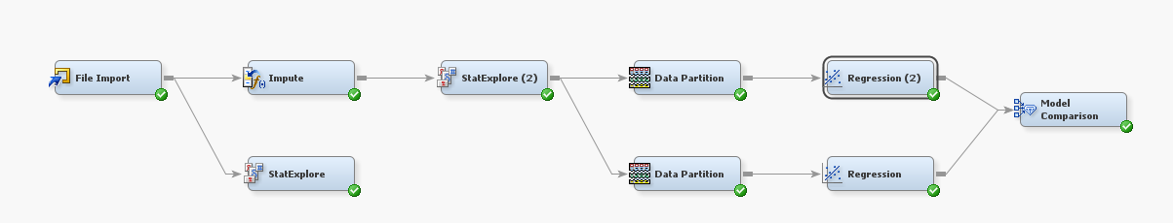
we have used Stepwise linear regression as it is like forward selection except that at each step, we consider dropping predictors that are not statistically significant, as in backward elimination.
The “first step” will identify the “best” one-variable model. Subsequent steps will identify the “best” two-variable, three-variable, etc. models

Slide 9
MODEL COMPARISION OF REGRESSION MODELS
The use of the model comparison node is to compare the models to which the node is connected, and predictions can be done accordingly
we compared the two regression models used before and we compared them to find the best one among the two.
The model comparison criteria is based on Average Square Error.

Slide 10
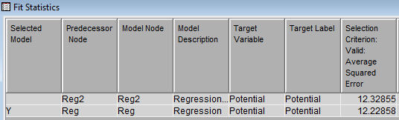
From the above figure we can see that the value of average squared error for both the regression models are 12.32 and 12.22, respectively. The model which has the least average squared error is the best model.
The linear regression model with the data partition as 60,30, and 10 for train, validation and test respectively is the best among the two models.

Slide 11
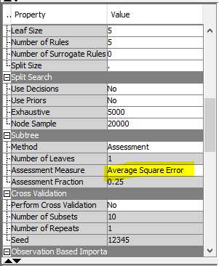
DECISION TREE
We have modeled and compared two linear regression models with different data partitioning, we want to fit a tree model to determine whether it will make better predictions.
On the Model tab, we dragged two nodes (Decision Tree, Decision Tree (2)) to our diagram workspace. We connected the Data Partition node to the Decision Tree node.

Slide 12
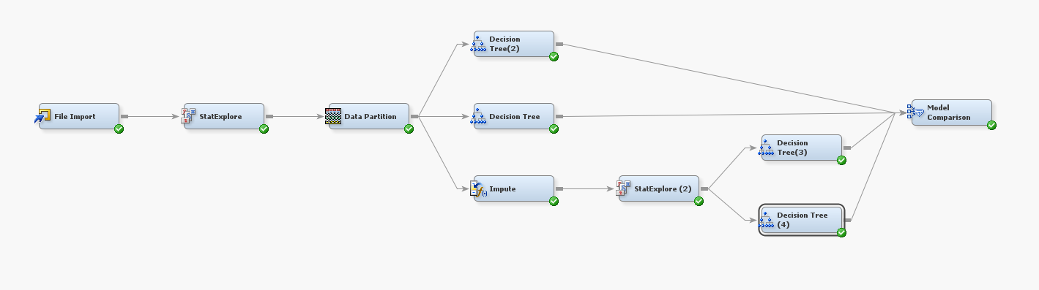
As Tree models handle missing values differently than regression models, so we have directly connected the Data Partition node to the Decision Tree node. We also added another 2 decision tree nodes (Decision Tree (3), Decision Tree (4)) to Impute node so that we can compare these models with one another.

Slide 13
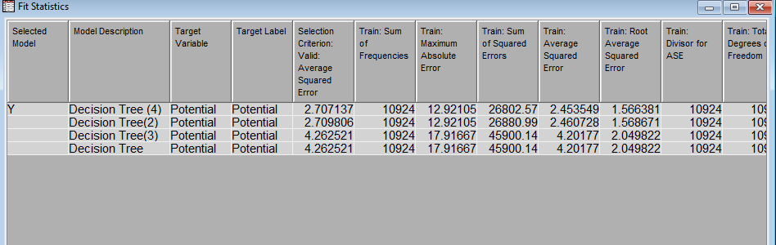
The Fit Statistics window displays several computed statistics for the tree model. These are computed for all partitions of the training data.
The Fit Statistics window confirms that the Decision Tree (4) model with 3 maximum branches is the better model based on the selection criteria of the Model Comparison node.

Slide 14
NEURAL NETWORK
Neural networks are a class of parametric models that can accommodate a wider variety of nonlinear relationships between a set of predictors and a target variable than can logistic regression.
Neural networks are networks in which there is an input layer consisting of nodes that simply accept the input values. The outputs of nodes in a layer are inputs to nodes in the next layer. The last layer is called the output layer.
Layers between the input and output layers are known as hidden layers
Neural Network has 3 hidden layers which is a default value for any neural network node

Slide 15
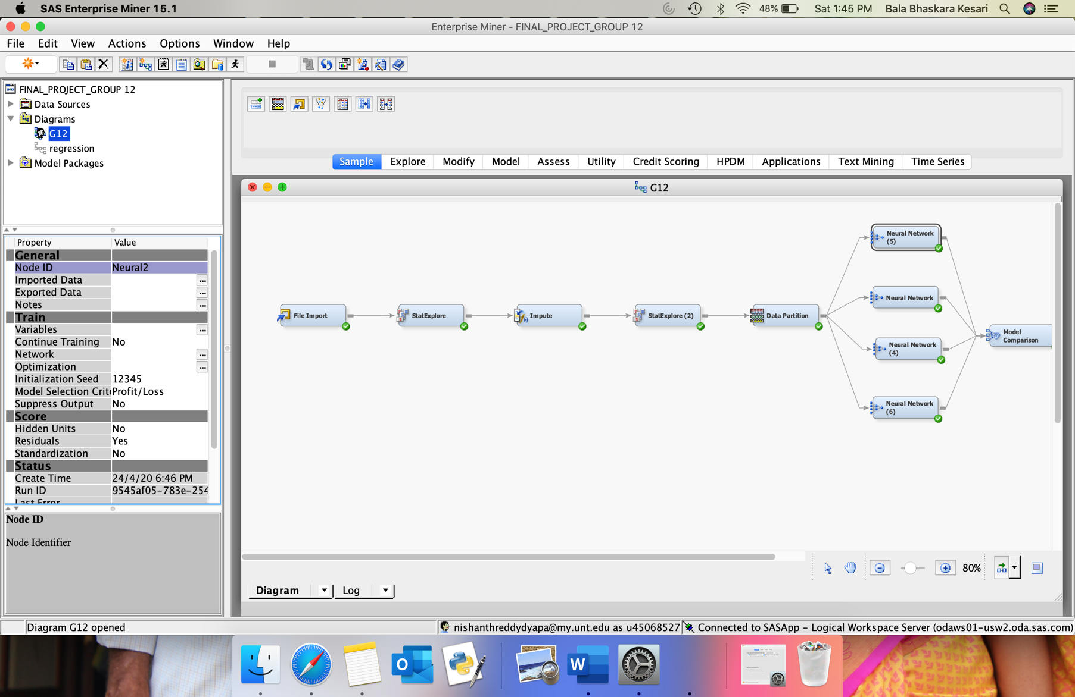
After placing all the required neural network nodes, we have used Model Comparison node from Assess tab to compare different neural networks.
In order to compare the models, we used average squared error as selection criteria.
Average squared error is measure of how close a fitted line is to data points

Slide 16
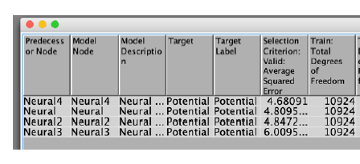
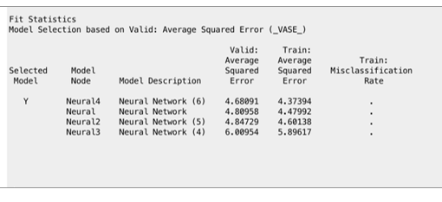
We can observe that for Neural Network with 6 hidden layers the Average squared error is less which means that it has better performance than other networks
Therefore, our network with 6 hidden layers proves to be a better fit to the input data.

Slide 17
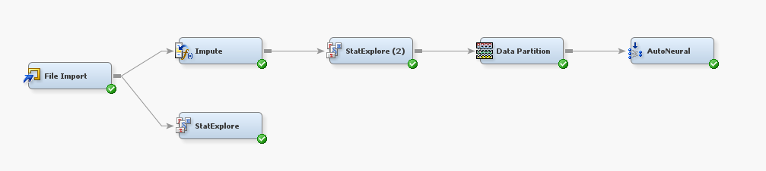
AUTO NEURAL NODE
The difference between a Neural node and AutoNeural node is that, the Neural Network node trains a specific neural network configuration
This node is best used when we know a lot about the structure of the model that we want to define

Slide 18
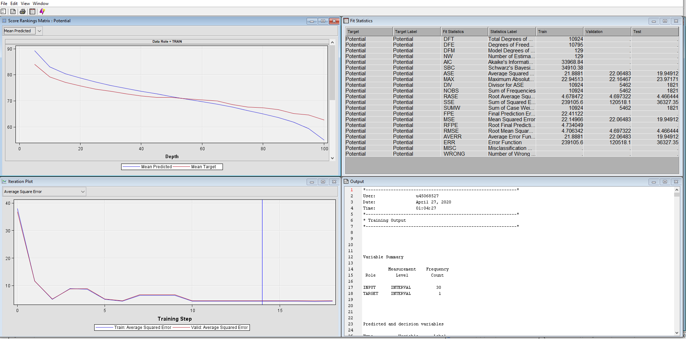
The Average Square error for this model is 21.881 which is very high when compared with all the previous models.

Slide 19
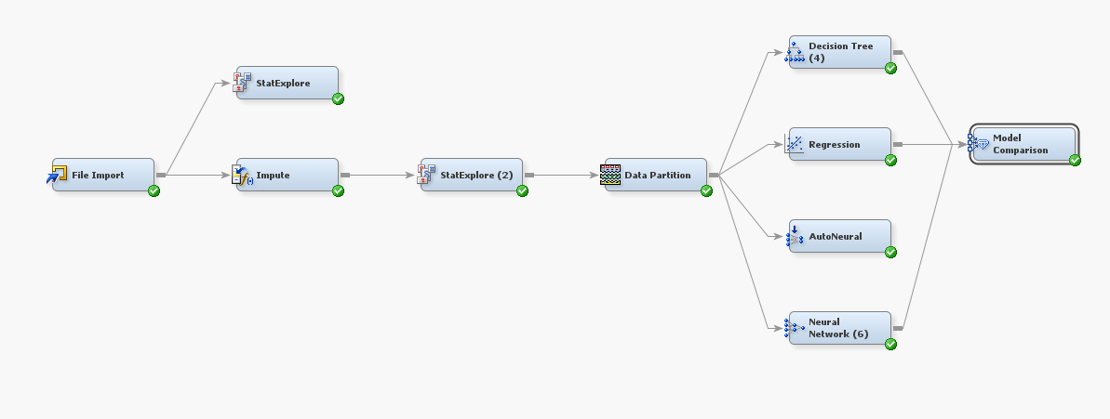
CHOOSING THE BEST MODEL
We used the Model Comparison node to compare the models that we have built in this project and to select one as the champion model.
From the regression model the, node with the name Regression is selected.
From the Decision Tree model, the node with the name Decision tree (4) is selected.
From the Neural Network model, the node with the name Neural Network (6) is selected.
From the AutoNeural model, the node with the name AutoNeural is selected.

Slide 20
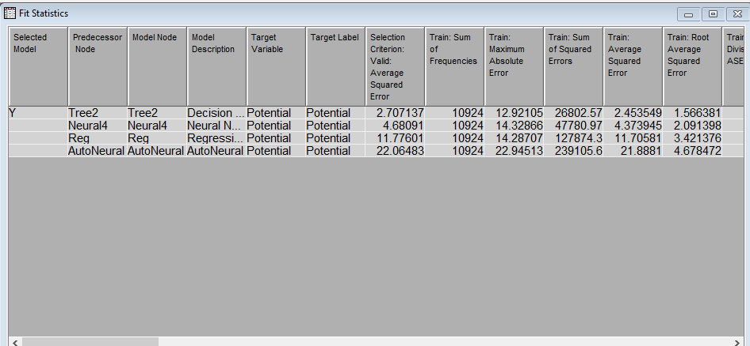
In the Fit Statistics window, notice that the Decision Tree (4) model was selected as the champion model. The champion model has the value Y in the Selected Model column in the Fit Statistics window. In the model selection node, SAS Enterprise Miner selects the champion model based on the value of a single statistic. We can specify which statistic to use for selection in the node Properties Panel. Here, we chose ASE as selection criterion.

Slide 21
CONCLUSION
We have implemented a prediction system to predict if a player’s performance is dependent on the age. It is evident that age of a player almost effects 50% of their performance.
We have also created a best model to predict the player.
Out of all the models Decision Tree stood out with best performance with least Average Squared error of 2.7071.
These predictions will help us whether to consider a player’s age in a critical situation and to predict the potential player which can help team to deliver a better performance.

Slide 22
THANK YOU

